Slide 1
Next step is to consider a range of possible careers.
In your last careers session you looked at the skills that employers look for and considered how you could demonstrate these skills.
www.plotr.co.uk
Log on to this website and register. Work your way through the

Slide 2
Click on the register button

Slide 3
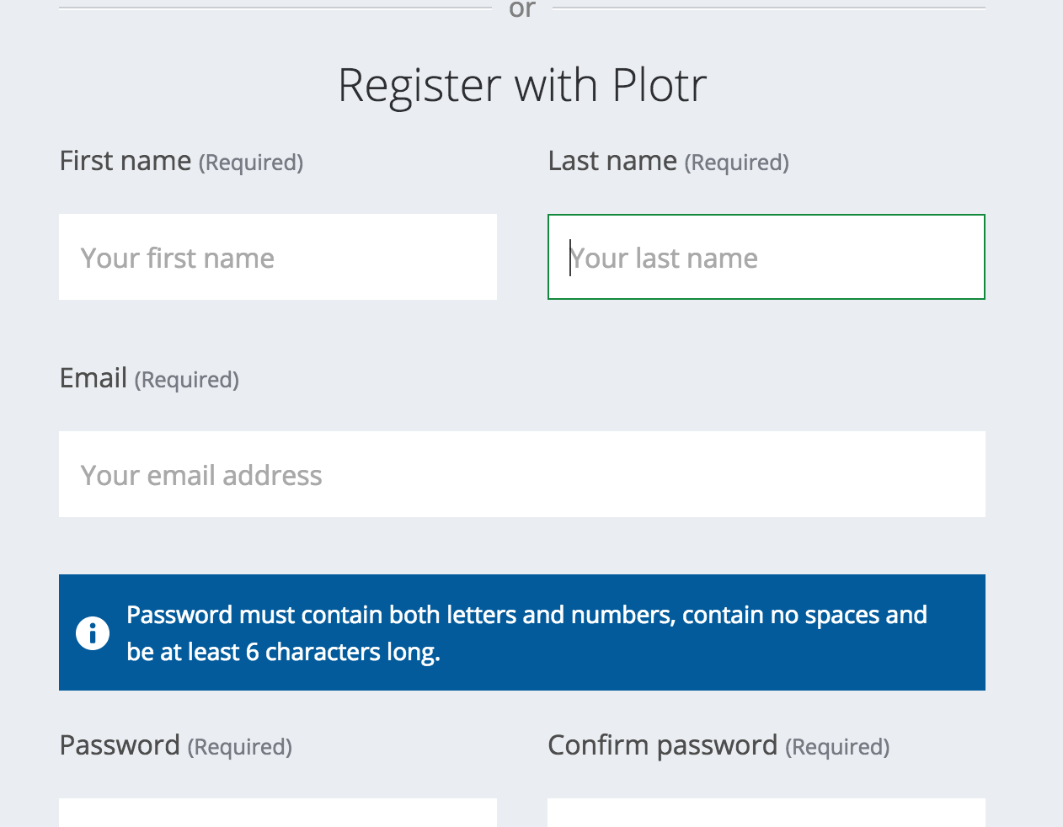

Slide 6
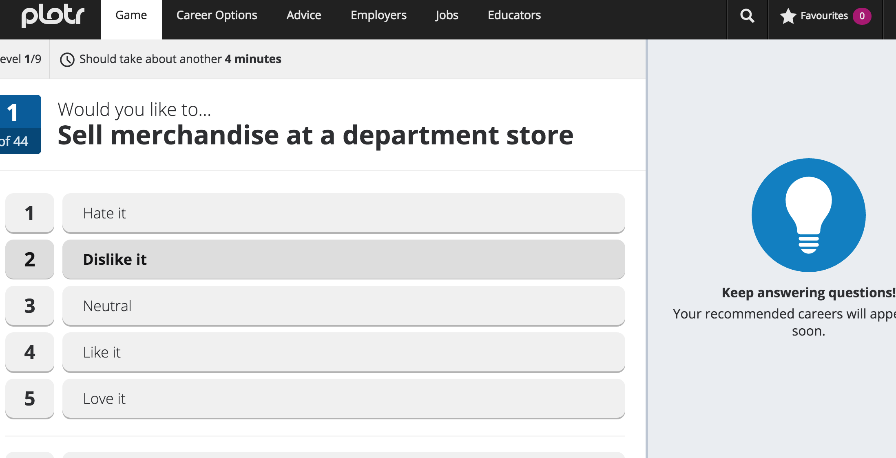
Answer each question honestly – and career suggestions will appear here

Slide 7
Next step is to consider a range of possible careers.
www.plotr.co.uk
Log on to this website and register. Work your way through the

Slide 8
In the next section you have to order the “must haves” for your career.

Slide 9
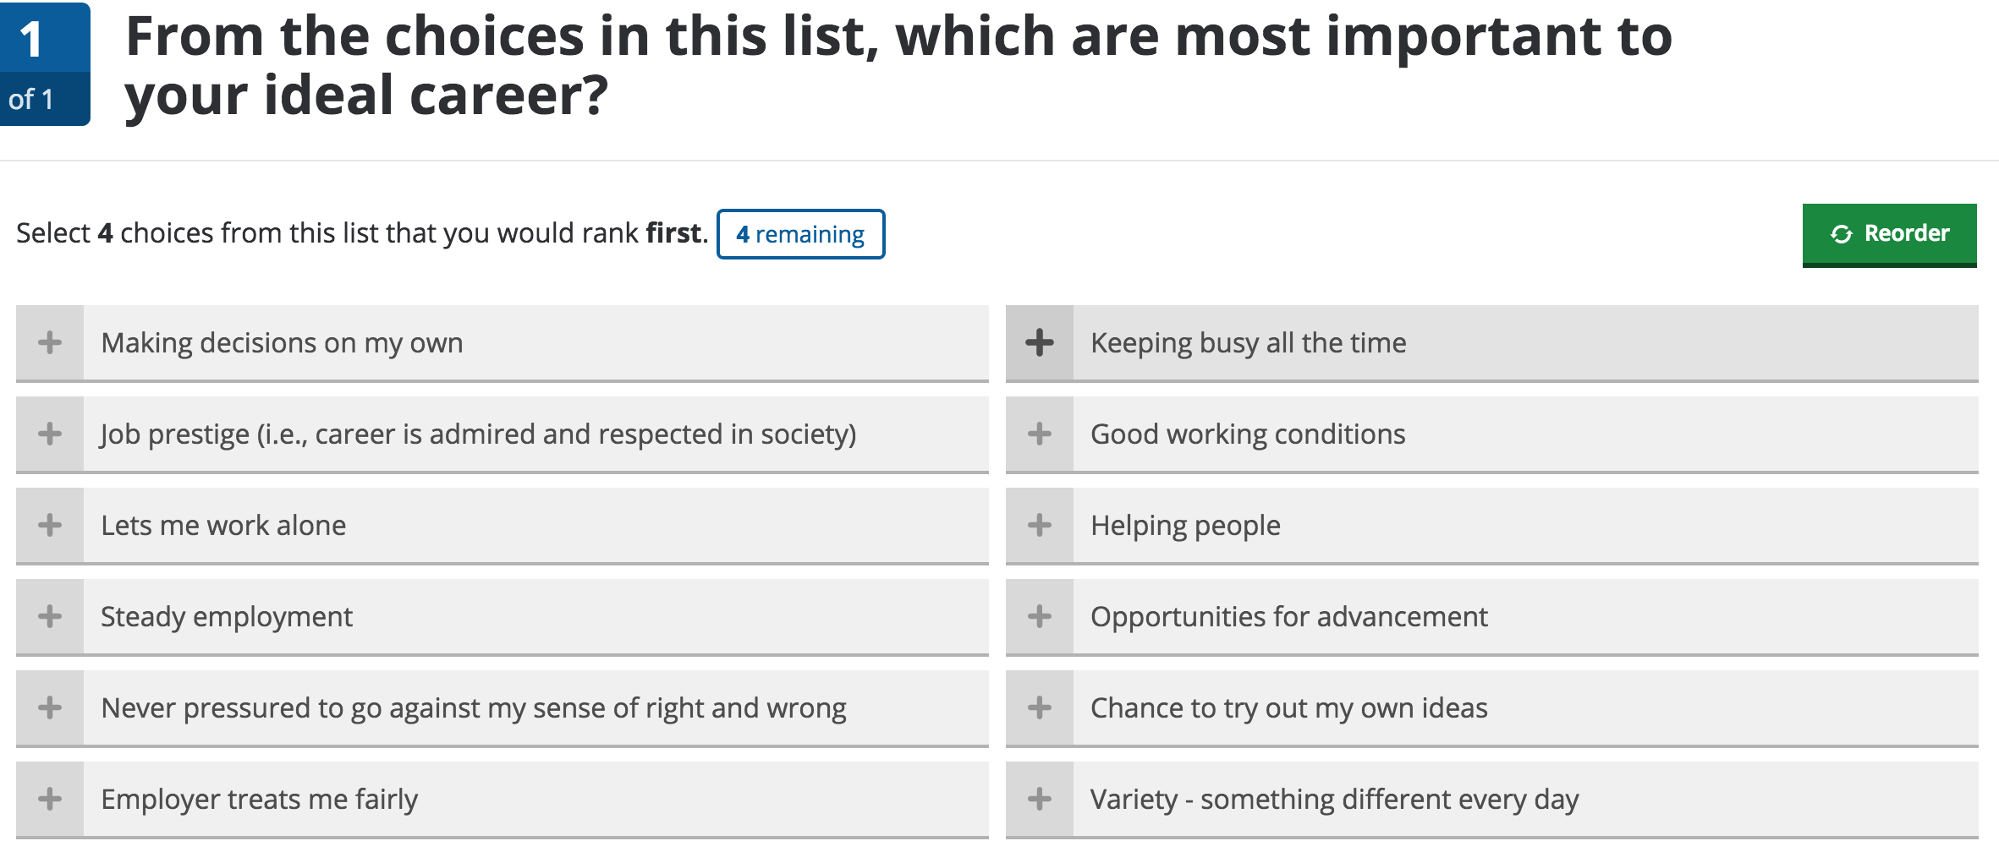
Select your first 4 top most important “must haves” by clicking on the +’s

Slide 10
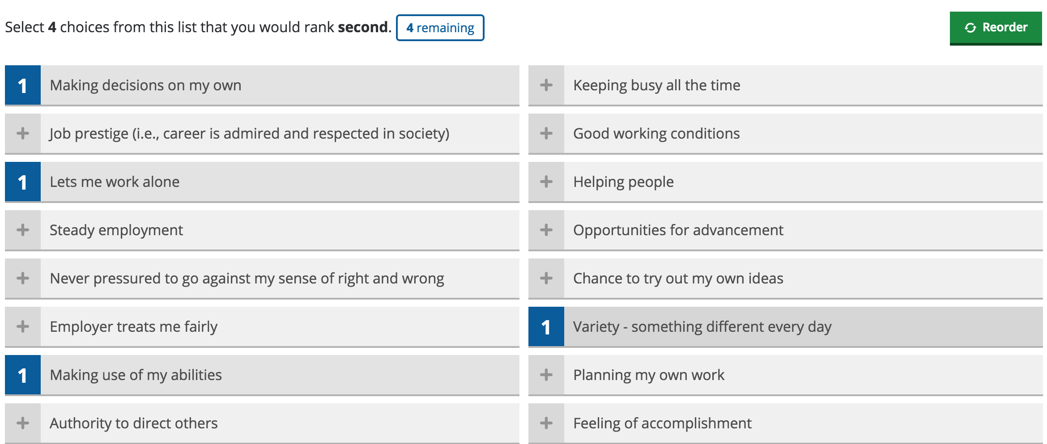
As you click they will turn to a “1”.
You then click your second choices

Slide 11
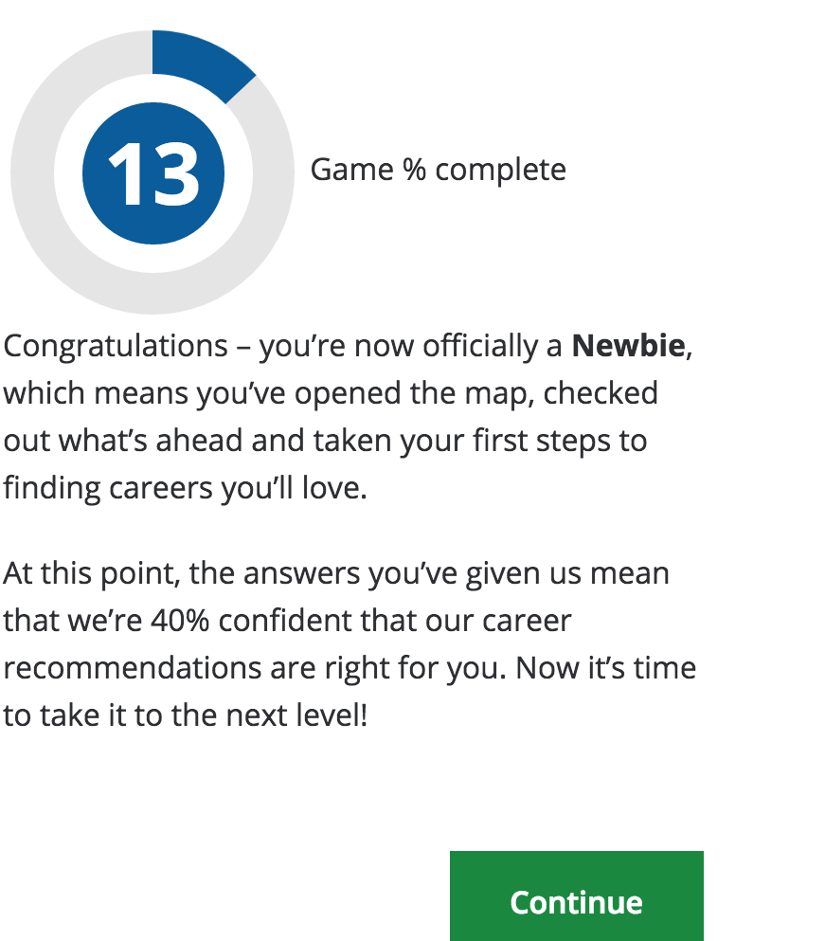
Second section is now complete click on the “continue” button

Slide 12
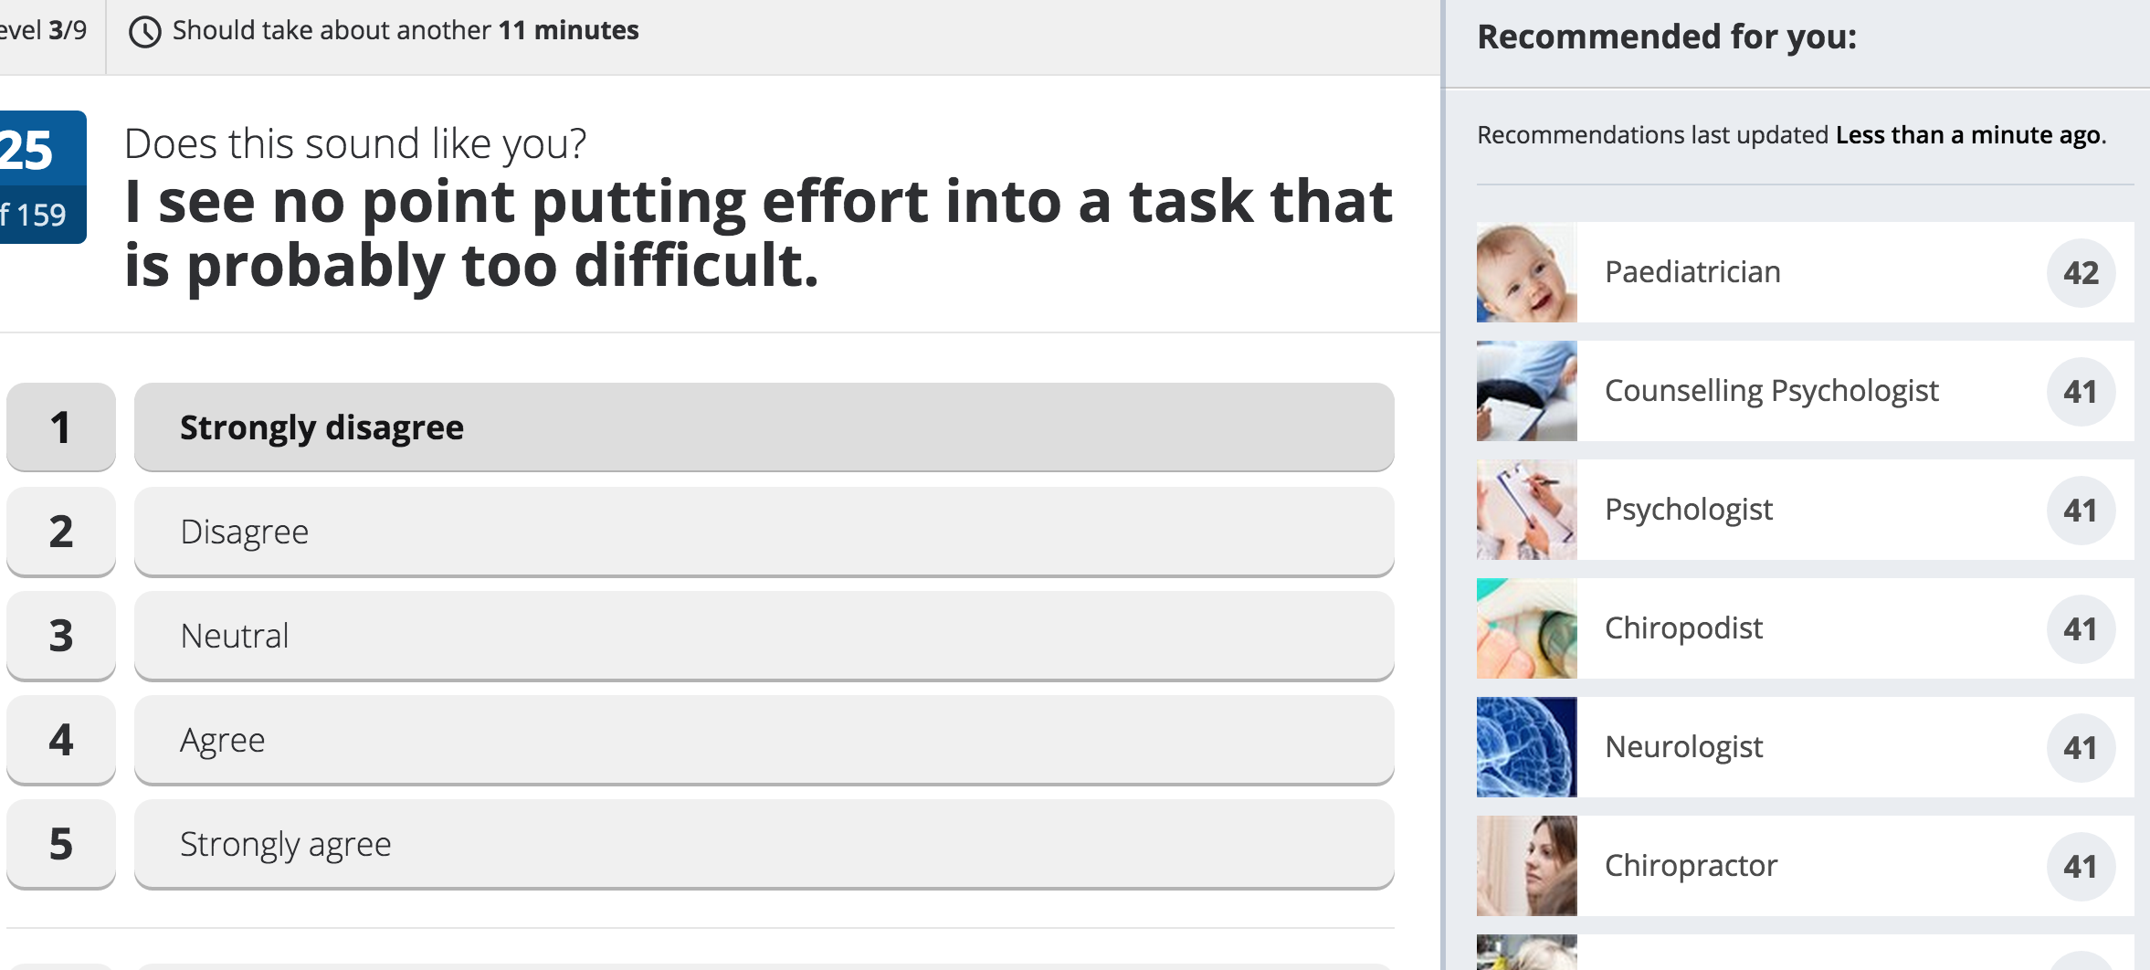
Your careers will start to appear here. As you scroll down more careers will appear at the bottom.

Slide 13
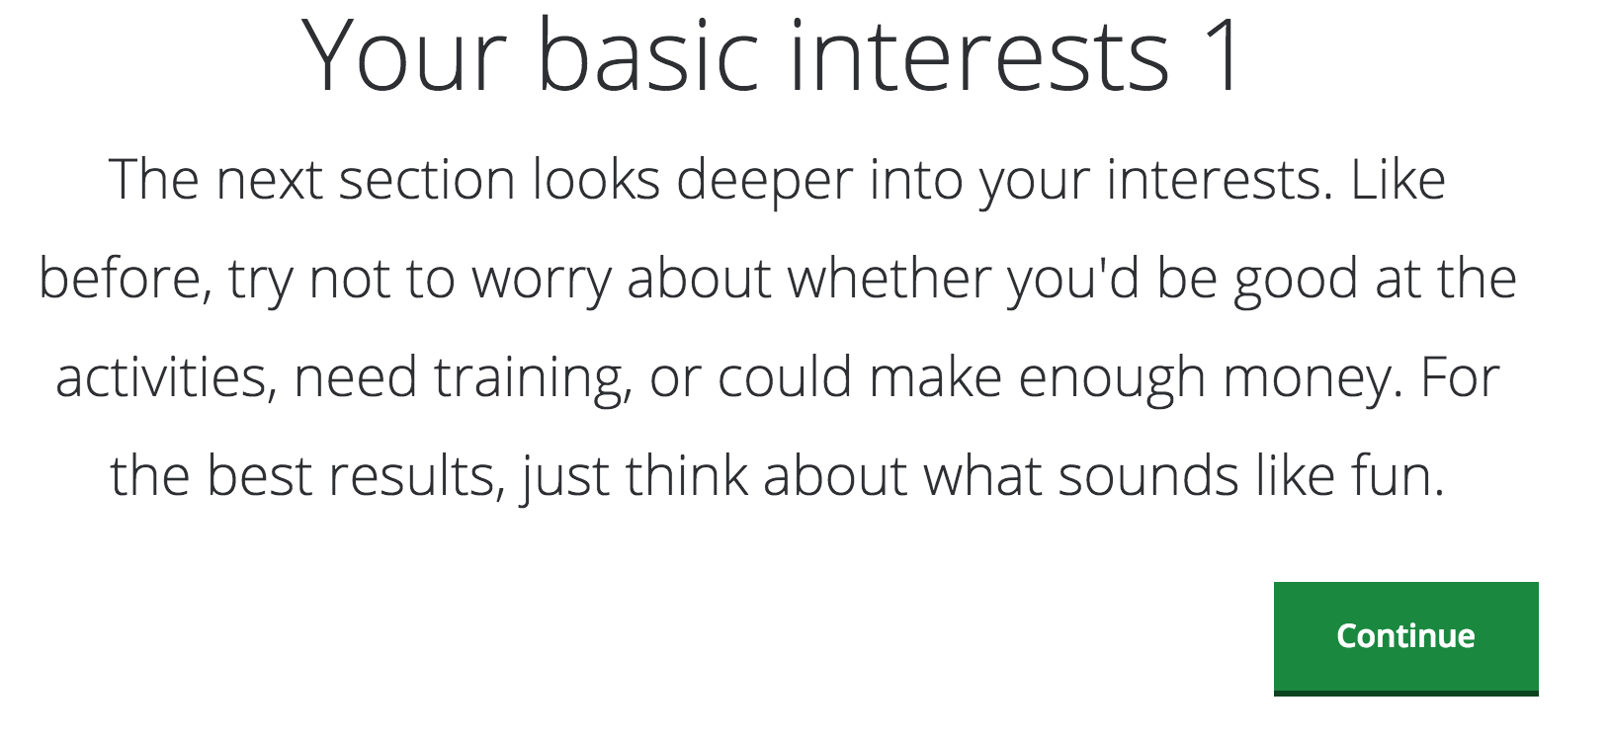
Section 3

Slide 14
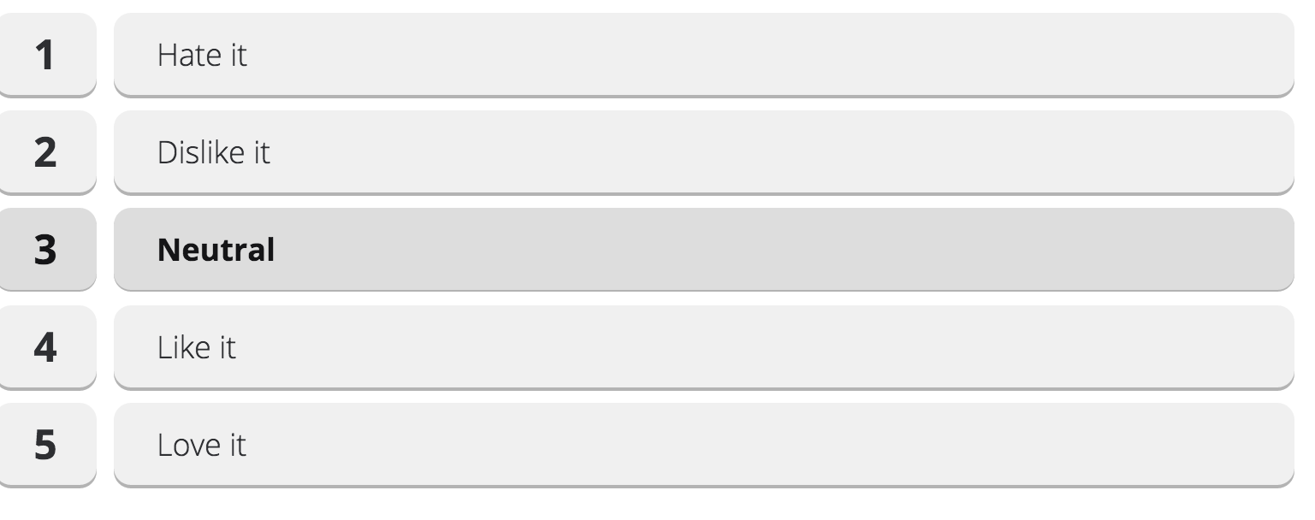
If you have no real feeling, positive or neutral about a question click neutral but if you can try to make a choice.

Slide 15
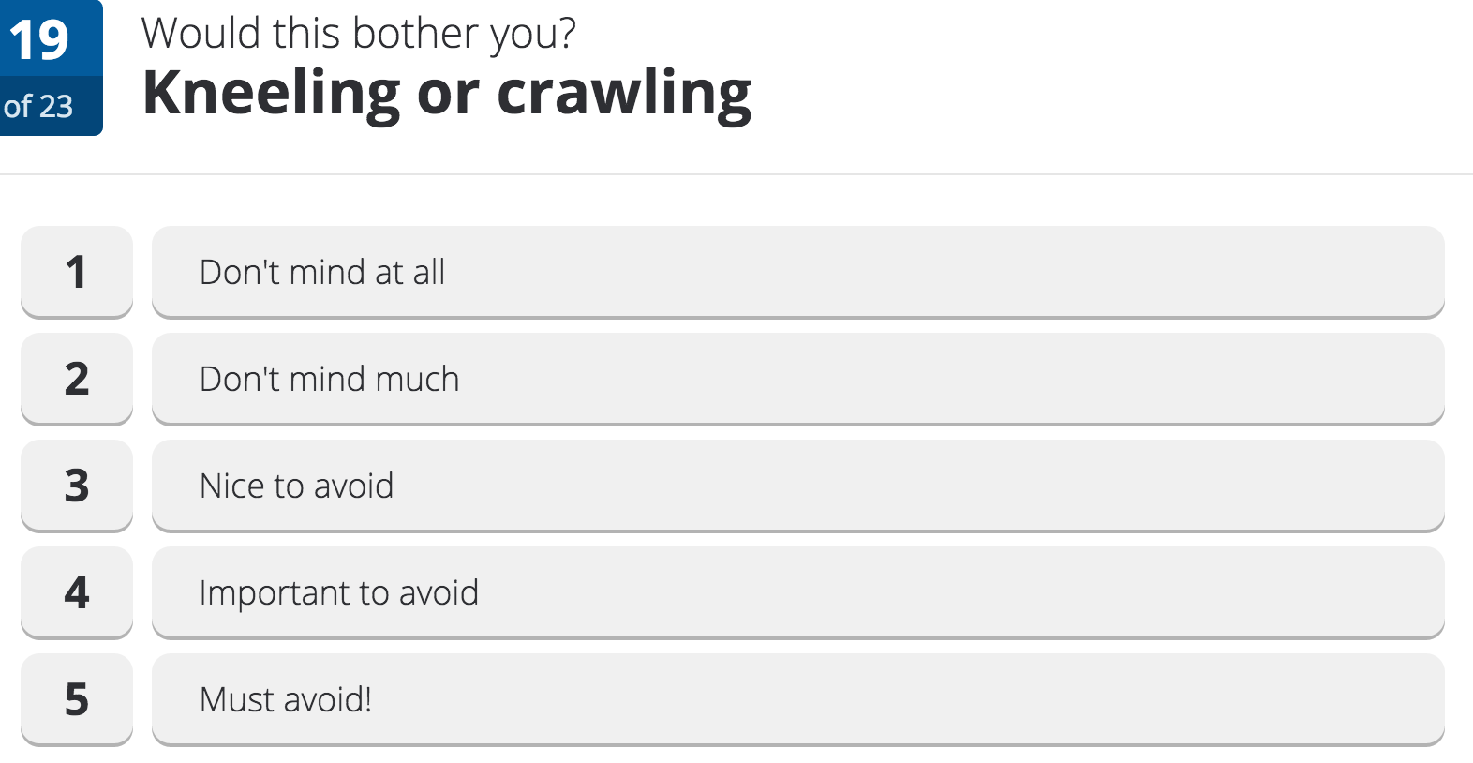

Slide 16
If you do not understand a phrase look below for the explanation.

Slide 17
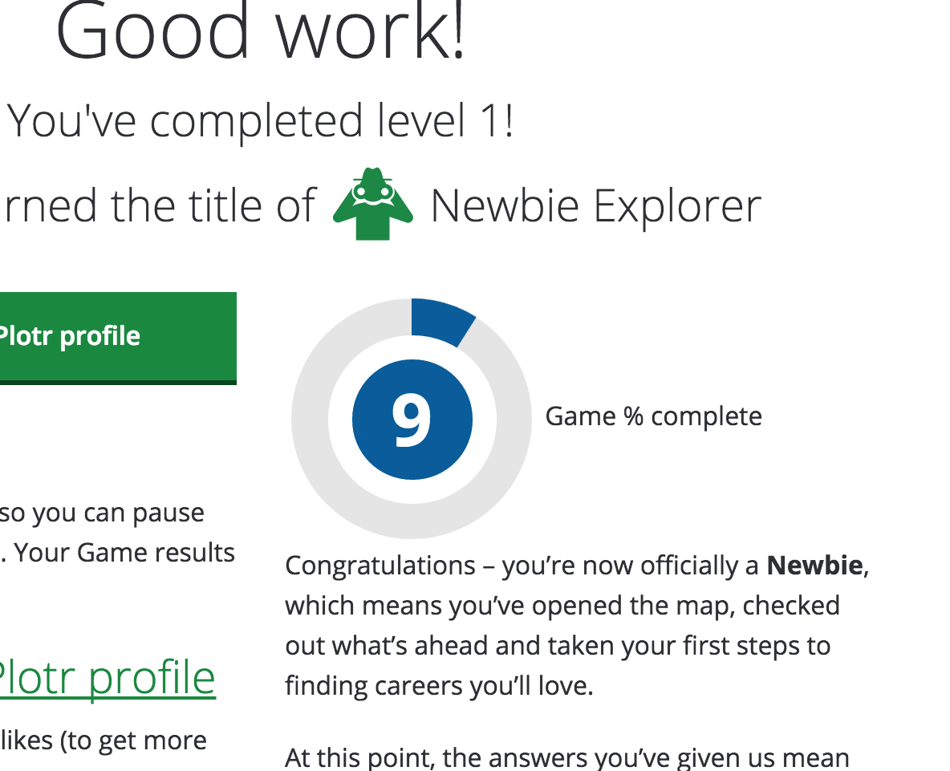
All of the questions are in sections – you will see possible careers appear on the right hand side of the screen

