Slide 1
In Careers session 1- you look at the skills that employers are looking for and then used the STAR technique to In Careers session 2 - last week you used Plotr to start to identify possible careers. This week you will:
Use keywords and phrases to describe your personality
Identify your interests and start to think about how these interests could match to certain jobs.
Revisit the skills that employers are looking for and identify your key skills.

Slide 2
Remember from the first lesson that the three areas that will help you to decide on possible courses and careers are:
If you want to secure a place on a course or be successful in an apprenticeship/job application, you must be able to demonstrate these three areas on your CV, in your covering letter, and at interview.
Skills
Interests
Personality
Your possible career.
Decide on some aims for the future

Slide 3
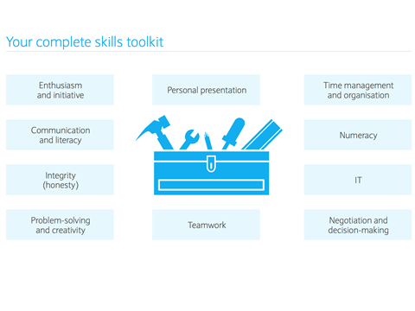
Can anyone remember any of the 10 key skills that employers look for?
Notes:
Click and the skills will appear on the screen.

Slide 4
Now you need to consider your personality, because this is one of the key three factors that should influence your choice of course or job.
If you want to secure a place on a course or be successful in an apprenticeship/job application, you must be able to demonstrate these three areas on your CV, in your covering letter, and at interview.
Skills
Interests
Personality
Your possible career.
Decide on some aims for the future

Slide 5
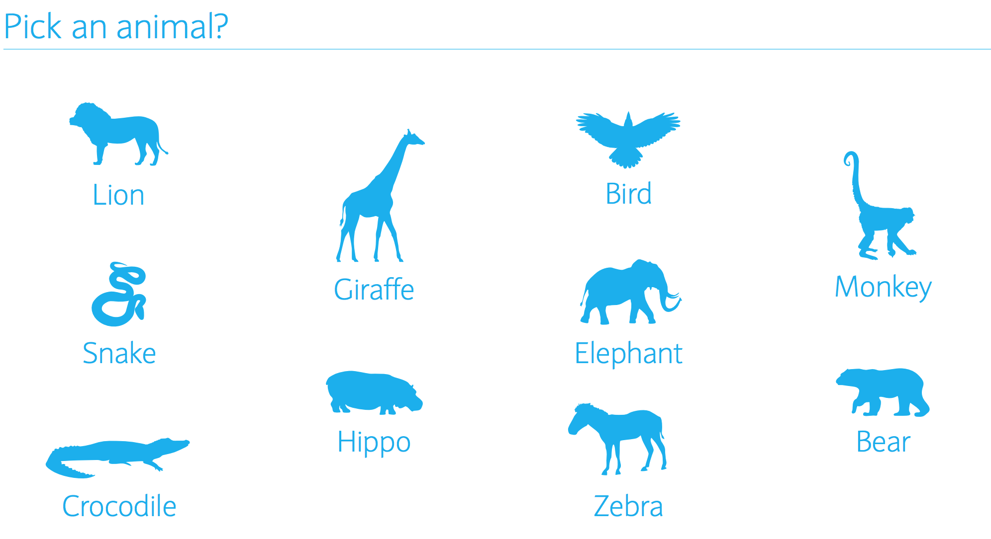
Which animal do you think you are most like and why? Talk to your partner, describe what characteristics you think that you share with the animal.

Slide 6
Talk to your partner, and ask them to describe what sort of person that they think that you are.
For example, trustworthy, fun, energetic

Slide 7
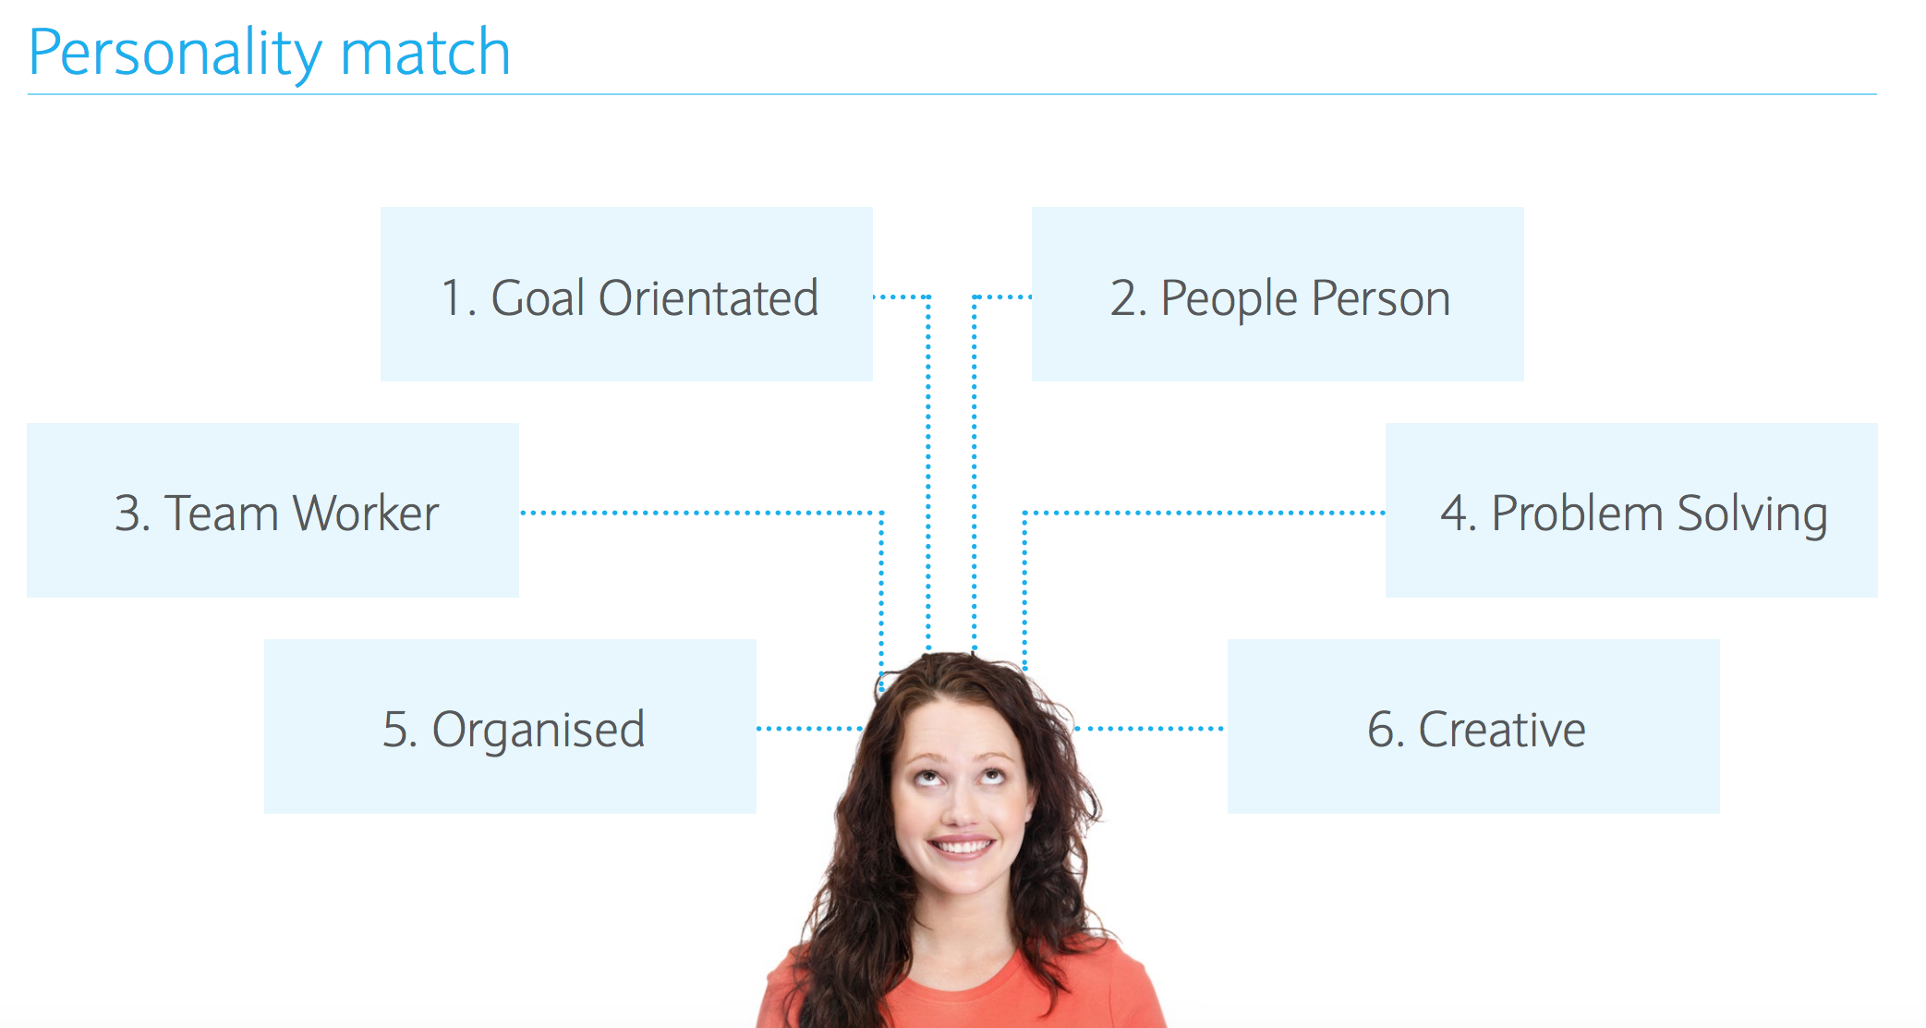
Which of these do you think most closely matches you? Put the numbers in order on your sheet

Slide 8
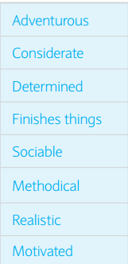
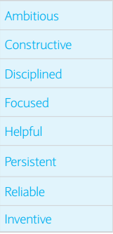
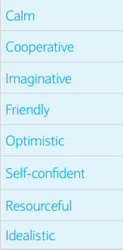
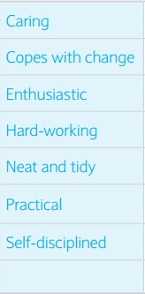
Your friend has described how they see you. Now choose the top 10 that you would use to describe yourself. (this is in your workbook)
At the bottom of your list, add any other adjectives/phrases that you could use to describe yourself.

Slide 9
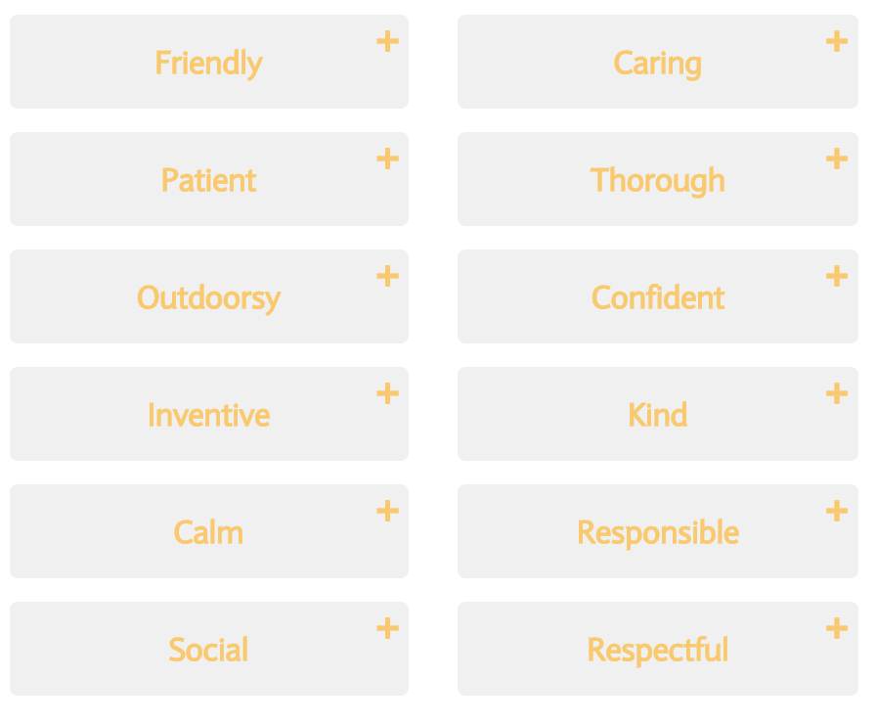
These are other possible words to describe your personality.

Slide 10
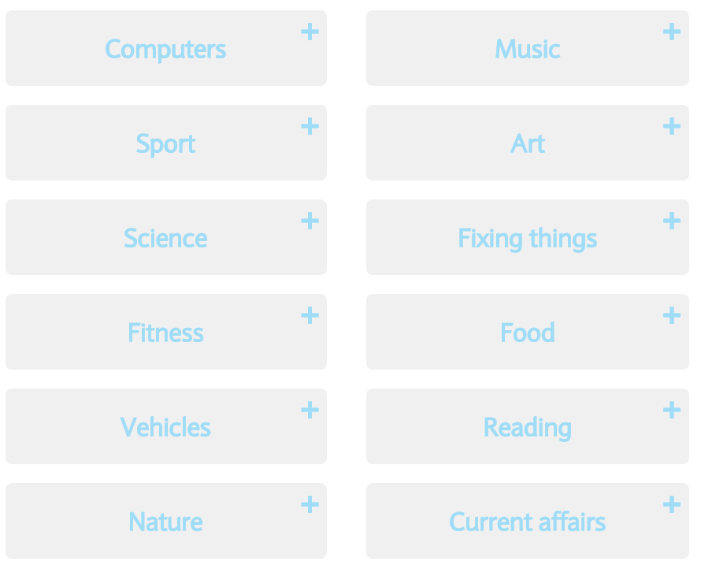
What are your interests? What do you enjoy doing in your spare time?
Use the list on the right, or your own ideas to list at least 5 things you are interested in – things that you enjoy. These could be subjects in school, hobbies or sports outside of school, or particular types of television that you enjoy watching.
1.
2.
3.
4.
5.

Slide 11
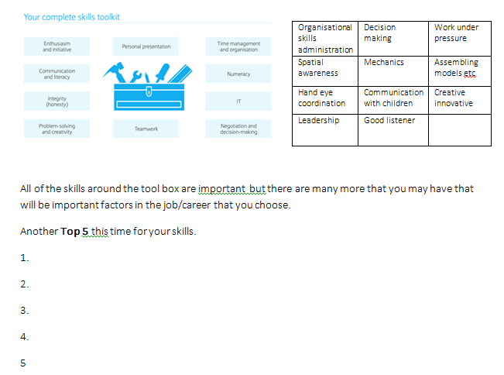
Now back to skills

Slide 12
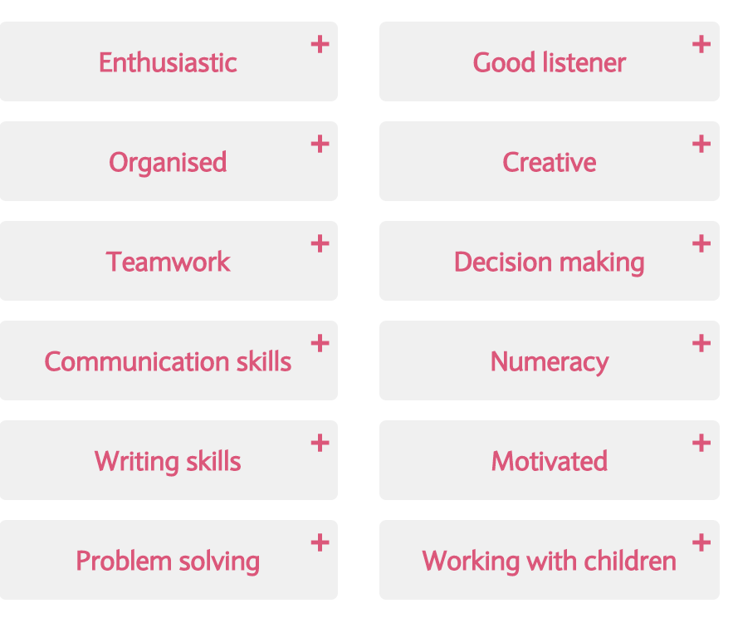
What are you good at, what skills do you have? Complete your top 5 skills

Slide 13
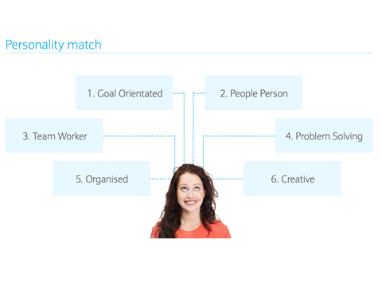
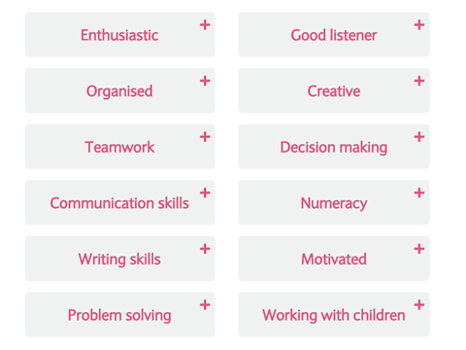
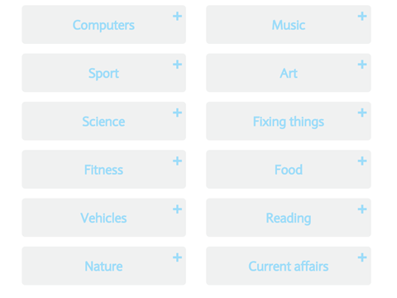
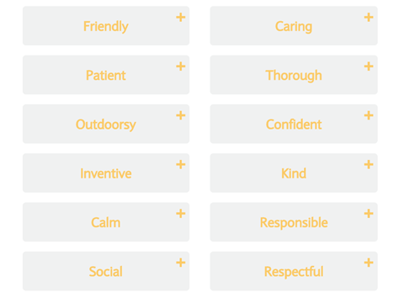

Slide 14
Now complete this section of your booklet.
Choose your top 5 for each area.
Skills
Interests
Personality

Slide 15
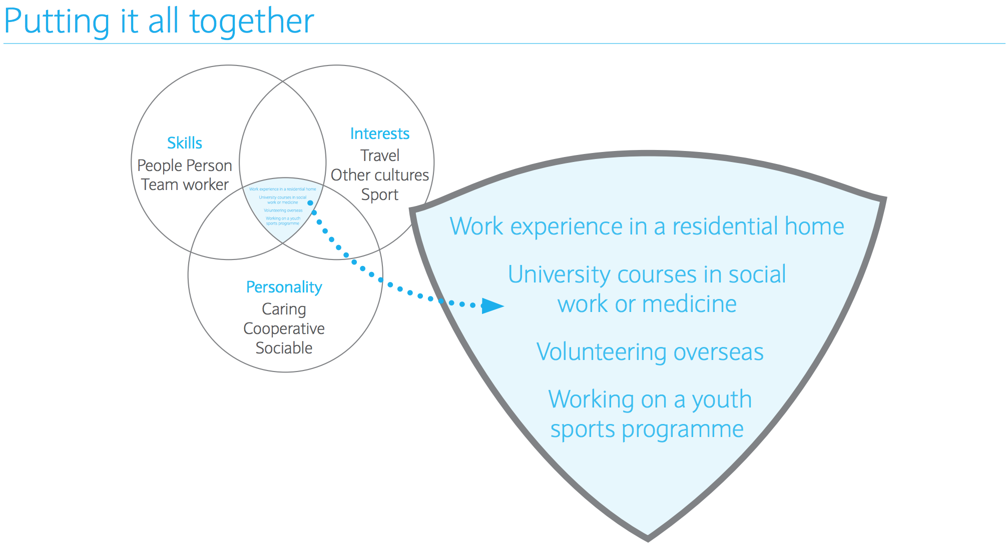

Slide 16
Write a STAR to describe how you have demonstrated one of the skills
S
T
A
R

Slide 17
Extension leading to the next session on updating and improving your CV
Now move on to Careers Session 4 that provides guidance on how to write a CV.
Most of you have a CV, some have not completed one so now use what you have learned about skills, motivations, and interests to improve or write one!
Session 4

Slide 18
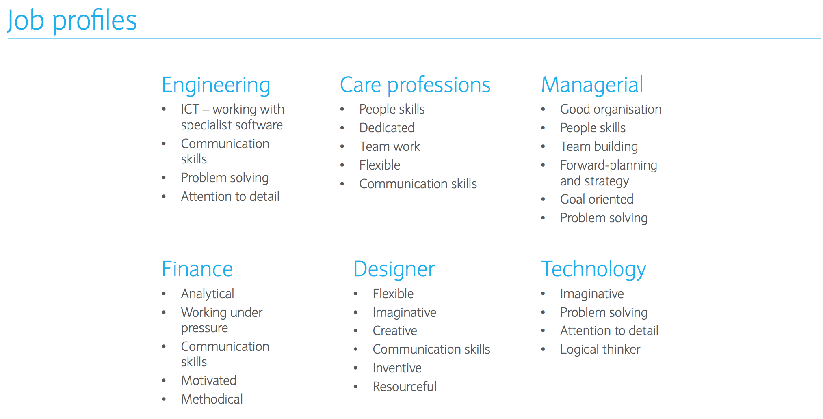
Extension leading to the next session – linking with session 5
What skills do you would need for each of these professions?

